Slide 1
5.2 Binary alloy system of the Copper-Nickel phase diagram
Example of isomorphous system: Cu-Ni (the complete solubility occurs because both Cu and Ni have the same crystal structure, FCC, similar radii and electronegativity) “isomorphous if they are closely similar in shape”.

Slide 2
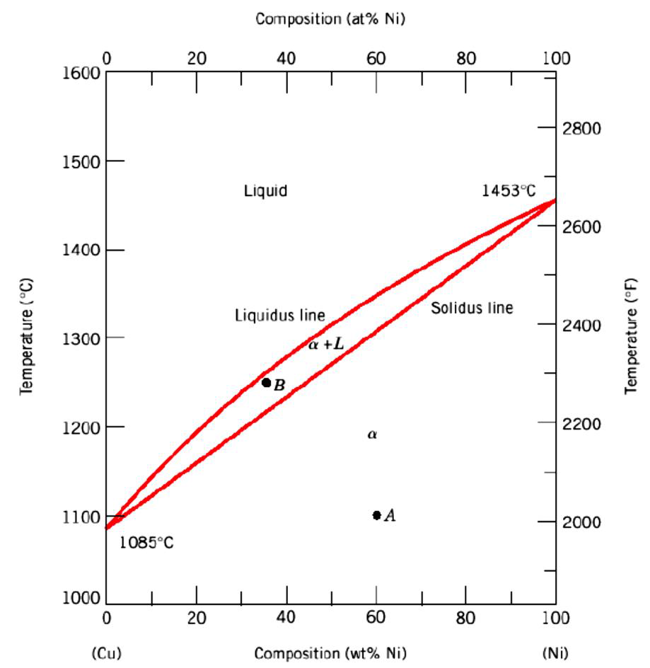
Figure 22 Cu-Ni phase diagram

Slide 3
The important points in the phase diagram can be summarised her and are shown graphically in Figure 23.
• Solidification in the solid + liquid phase occurs gradually upon cooling from the liquids line.
• The composition of the solid and the liquid change gradually during cooling (as can be determined by the tie-line method.)
• Nuclei of the solid phase form and they grow to consume all the liquid at the solidus line.

Slide 4
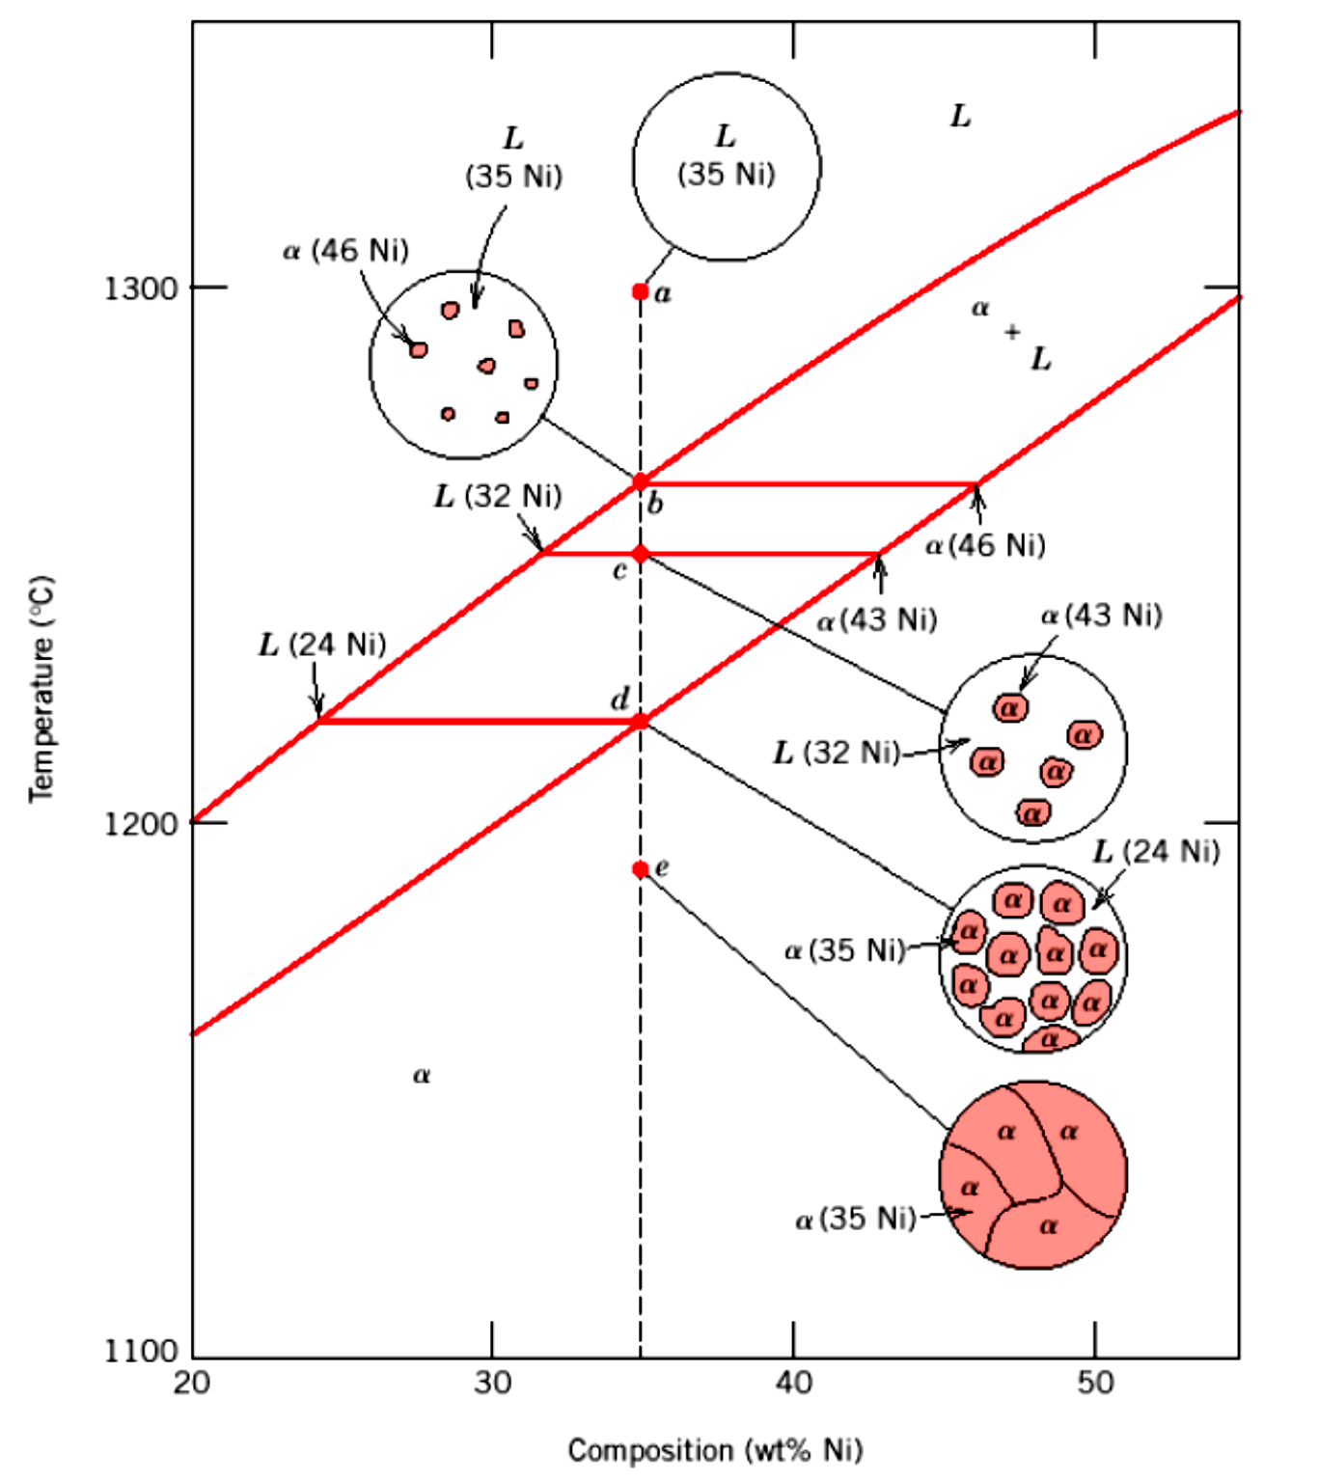
Figure 23 Solid and the liquid change during cooling in the Cu-Ni system

Slide 5
5.2.1 Clarification of a binary phase diagrams
For a given temperature and composition we can use phase diagram to determine:
1) The phases that are present
2) Compositions of the phases
3) The relative fractions of the phases
5.2.2 Finding the composition in a two phase region:
1. Locate composition and temperature in diagram
2. In two phase region draw the tie line or isotherm
3. Note intersection with phase boundaries. Read compositions at the intersections.
The liquid and solid phases have these compositions as shown in the below.

Slide 6
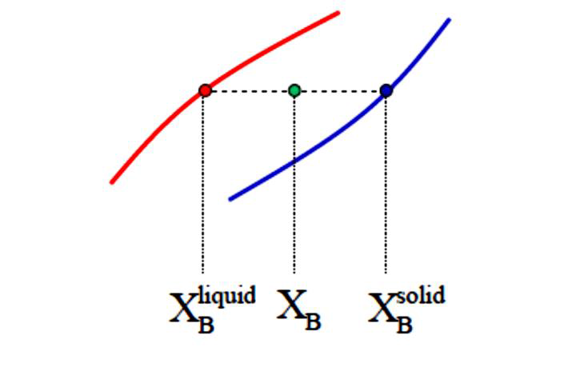
Figure 24 Explanation of the composition in the liquid and solid phases

Slide 7
In order to find the amounts of phases in a two phase region, the lever rule is used this can be done by using steps below:
• Locate composition and temperature in diagram
• In two phase region draw the tie line or isotherm
• Fraction of a phase is determined by taking the length of the tie line to the phase boundary for the other phase, and dividing by the total length of tie line as shown in Figure 25

